Slide 1

MySQL HA Solutions
Selecting the best approach to protect access to your data
Andrew Morgan – Director MySQL Product Management
Andrew.morgan@oracle.com
@andrewmorgan
clusterdb.com
February 2015

Slide 2
Notes:
This is a Safe Harbor Front slide, one of two Safe Harbor Statement slides included in this template.
One of the Safe Harbor slides must be used if your presentation covers material affected by Oracle’s Revenue Recognition Policy
To learn more about this policy, e-mail: Revrec-americasiebc_us@oracle.com
For internal communication, Safe Harbor Statements are not required. However, there is an applicable disclaimer (Exhibit E) that should be used, found in the Oracle Revenue Recognition Policy for Future Product Communications. Copy and paste this link into a web browser, to find out more information.
http://my.oracle.com/site/fin/gfo/GlobalProcesses/cnt452504.pdf
For all external communications such as press release, roadmaps, PowerPoint presentations, Safe Harbor Statements are required. You can refer to the link mentioned above to find out additional information/disclaimers required depending on your audience.

Slide 3








































Industry Leaders Rely on MySQL
Web & Enterprise
OEM & ISVs
Cloud
Notes:
MySQL is the world’s most popular open source database, and the #1 DB for web-based apps. MySQL powers the vast majority of top web sites WW including Facebook, Twitter and YouTube. MySQL is also very much used by enterprise and governmental organizations for web apps as well as custom and departmental enterprise applications, for example data marts. Those are very complementary use cases to the Oracle database that we’ll typically find more in ERPs and other such high end enterprise applications.
Additionally, MySQL is an extremely popular choice as embedded database, distributed by over 3.000 ISVs and OEMs. They include software vendors such as Sage embedding MySQL in accounting applications or eClinicalWorks shipping MySQL within medical practice management software. MySQL is also integrated in security solutions delivered by Cisco or Checkpoint for example and in numerous telecom offerings from Alcatel Lucent, Avaya and many others.
Finally, MySQL has become the leading DB in the cloud, offered by the vast majority of cloud services providers, and powering countless SaaS applications.
Those are the target markets for MySQL, where the database naturally excels, and for which Oracle is making it better.

Slide 4
Driving new Database Requirements
Focus on driving the business rather than on infrastructure
In-Memory Real-Time Performance
Extreme Read & Write Scalability
Rock Solid Availability
Rapid Service Innovation
Notes:
Deliver new services to engage with new markets across new channels
Get business insight from data, in real time
Simplify architecture to reduce cost, ensure greater standardization
Fast time to market

Slide 5
Driving new Database Requirements
Focus on driving the business rather than on infrastructure
In-Memory Real-Time Performance
Extreme Read & Write Scalability
Rock Solid Availability
Rapid Service Innovation
Notes:
Deliver new services to engage with new markets across new channels
Get business insight from data, in real time
Simplify architecture to reduce cost, ensure greater standardization
Fast time to market

Slide 6

HA Considerations
SLA requirements to support business objectives
Operational capabilities
Service agility & time to market
Budgetary constraints
Notes:
Understanding both the direct and indirect costs of downtime for each application or service helps you determine:
The SLAs required by the business
Therefore, the HA technology chosen to meet those SLAs.
Also need to consider
Consider operational capabilities : what are skills in our devops team or cloud provider
Agility of service, as you dial up HA requirements, processes for change mgmt become more complex, reduce agility
Budget? Even open source s/w, still costs if buying in lots of redundant h/w, also operating costs

Slide 7
Don’t assume 99.999% HA needed for all apps
Recovery Time Objective
Maximum length of downtime before there is break in “business continuity”
Recovery Point Objective
Point in time to which data must be recovered when service is re-established
Tier 1
Tier 2
Tier 3
Tier 4
Mission-critical services
Business-critical services
Task-critical services
Non-critical services
Notes:
2 critical mterics in used to determine the availability requirements of an app are RTO and RPO
Recovery Time Objective (RTO):
define the maximum acceptable downtime per incident in order to avoid a break in business continuity. Length of downtime of an internal app sevicing 1 small dept will have a much longer RTO than an eCommerce engine
Recovery Point Objective (RPO):
The Recovery Point Objective is the point in time to which data must be recovered when a service is re-established. - for example financial transactions will demand a different RPO from clickstream data.. So Fin app could be microseconds whereasl log data could be days.
Understanding these metrics can be critical in determining the right HA solution
Many users will catergise their apps into 1 of 4 tiers
Tier 1, Mission-critical services
Trading, eCommerce, telecoms, access & authentication, etc.
Tier 2, Business-critical services
Web site, CRM, corporate-wide email, etc
Tier 3, Task-critical services
Feeds/blogs/wikis, product search, internal LoB
Tier 4, Non-critical services
Ie test / dev environments

Slide 8
Mapping Uptime to Availability
Replicated Systems
Clustered & Virtualized Systems
Shared Nothing, Geo-Replicated Clusters
SPs & Line of Business
Web & Cloud Services
eCommerce, Telecoms & Military
Cost & Complexity
9
9
.
9
9
9
%

Slide 9
MySQL HA Solutions
MySQL Replication
Windows/Solaris/Clusterware Clustering or Oracle VM
MySQL Cluster
MySQL Fabric
DRBD
9
9
.
9
9
9
%

Slide 10



Layers of HA
It’s not just reliably storing the data
Redundant App Servers
Routing to the Data
Redundant Access to Data
Data Redundancy

Slide 11
Oracle MySQL HA & Scaling Solutions
 | MySQL Replication | MySQL Fabric | Oracle VM Template | Oracle Clusterware | Solaris Cluster | Windows Cluster | DRBD | MySQL Cluster
App Auto-Failover | ✖ | ✔ | ✔ | ✔ | ✔ | ✔ | ✔ | ✔
Data Layer Auto-Failover | ✖ | ✔ | ✔ | ✔ | ✔ | ✔ | ✔ | ✔
Zero Data Loss | MySQL 5.7 | MySQL 5.7 | ✔ | ✔ | ✔ | ✔ | ✔ | ✔
Platform Support | All | All | Linux | Linux | Solaris | Windows | Linux | All
Clustering Mode | Master + Slaves | Master + Slaves | Active/Passive | Active/Passive | Active/Passive | Active/Passive | Active/Passive | Multi-Master
Failover Time | N/A | Secs | Secs + | Secs + | Secs + | Secs + | Secs + | < 1 Sec
Scale-out | Reads | ✔ | ✖ | ✖ | ✖ | ✖ | ✖ | ✔
Cross-shard operations | N/A | ✖ | N/A | N/A | N/A | N/A | N/A | ✔
Transparent routing | ✖ | For HA | ✔ | ✔ | ✔ | ✔ | ✔ | ✔
Shared Nothing | ✔ | ✔ | ✖ | ✖ | ✖ | ✖ | ✔ | ✔
Storage Engine | InnoDB+ | InnoDB+ | InnoDB+ | InnoDB+ | InnoDB+ | InnoDB+ | InnoDB+ | NDB
Single Vendor Support | ✔ | ✔ | ✔ | ✔ | ✔ | ✖ | ✔ | ✔

Slide 12






Why Replicate?
Duplicates database from a “master” to a “slave”
Redundant copies of the data provide foundation for High Availability
Scale out by distributing queries across the replication farm
Web / App Servers
Writes & Reads
Reads
Master
Slaves
Notes:
Built in since late 90s – big contributor to adoption of MySQL
Gives is ability to mirror database to a 1 or more slaves, basis for HA
Also scale out as multiple copies of db to direct queries to – send reads to slaves, and writes to master

Slide 13

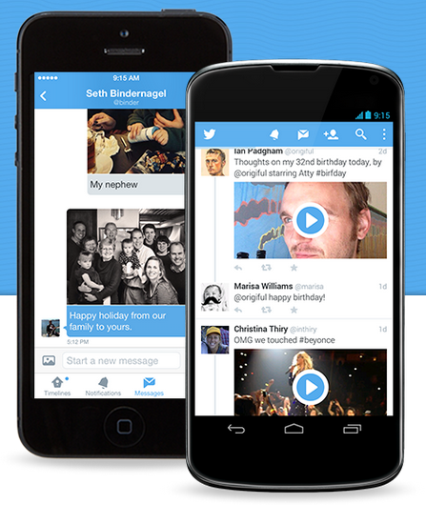
Twitter
Company Overview
Twitter’s mission: To give everyone the power to create and share ideas and information instantly, without barriers.
Application
A typical day sees over 500 million tweets, which means about 5,700 per second with MySQL. Twitter achieved in August 2013 a new World record of 143,199 Tweets Per Second (TPS).
Why MySQL 5.6?
“Performance, replication, compression improvements, transportable tablespaces, better monitoring & diagnostics.” Calvin Sun, Senior Engineering Manager, Twitter

Slide 14

Booking.com
Company Overview
Each day, over 700,000 room nights are reserved on Booking.com. Part of the Priceline Group.
Application
Booking has relied on MySQL since 2003. Supporting 60-70% annual growth and an agile development model.
Why MySQL?
Performance and scalability to manage a very large event volume:
60 MByte/sec Event data rate
2 Billion Events per day
15 TB in MySQL for Events, lookups, monitoring
150 TB MySQL Event archive

Slide 15



MySQL Replication Workflow
Binary Log
Relay Log
Session
Dump
I/O
SQL
Master
Database
Slave
Database
Session thread: processes queries from the application – writes data to master database & associated events to binary log
Dump thread: reads events from binary log and sends them to a slave
I/O thread: receives replication events and stores them in slave’s relay log
SQL thread: reads replication events from slave’s relay log and applies them to slave database
Notes:
Look more at workflow
Slave could be master for another set of slaves - daisychained

Slide 16
Asynchronous vs. Synchronous Replication
Asynchronous
MySQL Default
In parallel: Master acks to app and sends transaction to slave
Fast
Risk of lost changes if master dies
Semi-Synchronous
MySQL 5.5+ - Enhanced in MySQL 5.7
Serially: Master waits for change to be received by slave then In parallel ack to app and apply changes on slave
Intermediate latency
Lossless (MySQL 5.7)
Synchronous
Only available with MySQL Cluster
Serially: Master waits for change to be applied on all slaves before ack to app
Higher latency
If Active/Active, best suited to small transactions
Lossless

Slide 17
MySQL 5.6 Replication
Performance and Scalability
Simplicity
Automation
Insurance
5x Higher slave throughput with MTS (multiple schemas)
Reduced master impact – Binlog Group Commit
Global Transaction IDs
MySQL Replication Utilities (including auto-failover)
Crash safety
Robustness
Replication checksums
Time Delayed Replication

Slide 18
MySQL 5.7 Replication – Pre-GA
Performance and Scalability
Monitoring
Intra-schema Multi-Threaded Slave
Performance Schema
Lossless Semi-Synchronous Replication
Resilience
Faster Master
Multiple Semi-Synchronous Acks
GTIDs stored in transactional tables
Operational Simplicity
Dynamic slave filters
On-line CHANGE MASTER
MORE Resilience
Automatic slave retries

Slide 19

Multi-Source Replication
labs.mysql.com
Binlog
Master 1
Master 2
…
…
Binlog
Master N
Binlog
Consolidate updates from multiple Masters into one Slave
Consolidated view of all shards
More flexible topologies
Centralized point for backups
Compatible with Semi-Sync Replication & enhanced MTS
Master-specific slave filters
IO 1
Relay 1
Coordinator
W1
W2
…
WX
IO 2
Relay 2
Coordinator
W1
W2
…
WX
…
…
Coordinator
W1
W2
…
WX
IO N
Relay N
Coordinator
W1
W2
…
WX
Slave

Slide 20



MySQL Group Replication
labs.mysql.com
Shared-nothing virtually synchronous database system
Multi-master update anywhere
Conflict detection and resolution (transaction rollback)
Optimistic State Machine Replication
Automatic group membership management and failure detection
No need for server fail-over
Elastic scale out/in
No single point of failure
Automatic reconfiguration
Well integrated
InnoDB
GTID-based replication
PERFORMANCE_SCHEMA
MySQL Server
Application
API
MySQL Masters
Replication Plugin
Group Comms (Corosync)

Slide 21

MySQL Fabric
An extensible and easy-to-use framework for managing a farm of MySQL server supporting high-availability and sharding

Slide 22

MySQL Fabric 1.5
High Availability + Sharding-Based Scale-out
High Availability
Server monitoring with auto-promotion and transparent application failover
Optionally scale-out through sharding
Application provides shard key
Range or Hash
Tools for resharding
Global updates & tables
Fabric-aware connectors rather than proxy: Python, Java, PHP, .NET, C (labs)
Lower latency, bottleneck-free
Server provisioning using OpenStack etc.
Connector
Application
Connector
Application
mappings
SQL
MySQL Fabric
Read-slaves
Read-slaves
HA group
HA group

Slide 23
MySQL Replication & MySQL Fabric HA
How this effects failover
MySQL Replication is the initial implementation used in HA Groups
PRIMARY = Replication Master & receives all writes
SECONDARY = Replication Slave & receives share of reads
Failover
MySQL Fabric detects failure of PRIMARY/Master
Selects a SECONDARY/Slave and promotes it
Updates State Store
Updated state fetched by Fabric-aware connectors

Slide 24
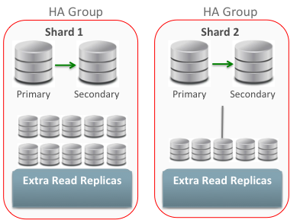
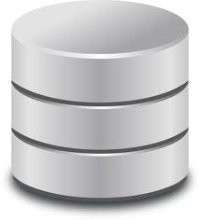
MySQL Fabric Node
Extensible Architecture
Connector
Connector
AMQP?
MySQL
XML-RPC
MySQL Fabric Framework
Shard
Connector
HA
SQL
Prov
???
Executor
State Store (persister)
State Store

Slide 25
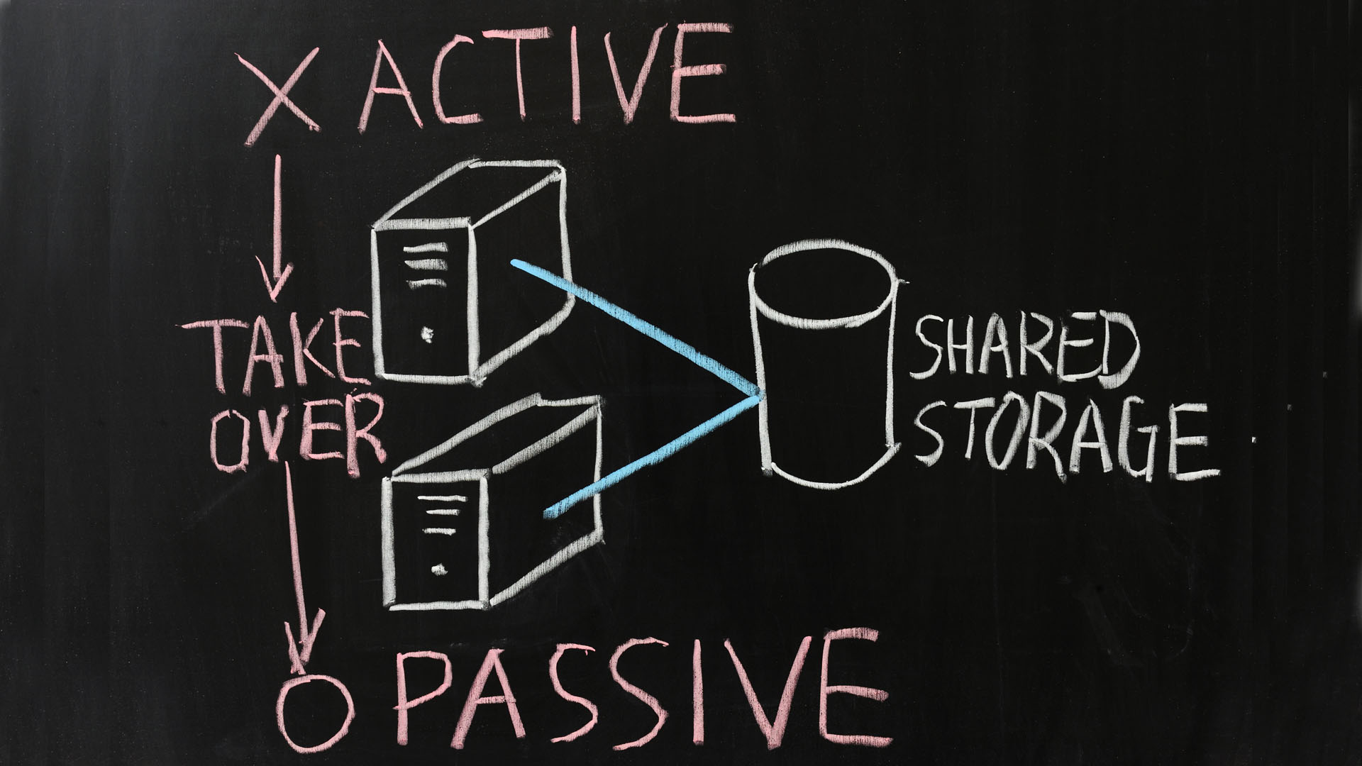

Slide 26
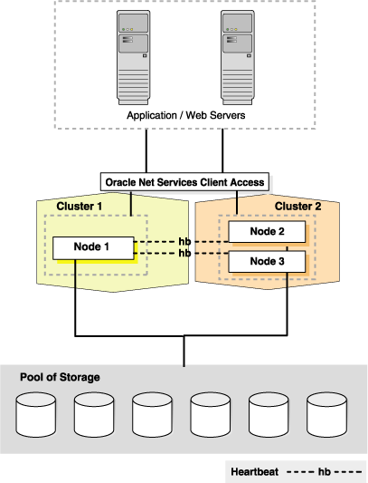
MySQL on Oracle Clusterware
Oracle Clusterware unifies servers in a server farm to form a cluster
At the core of Oracle RAC
Oracle Cluster 12c includes MySQL Server 5.6 agent
Planned migration and failover of MySQL database
Hidden from the application

Slide 27





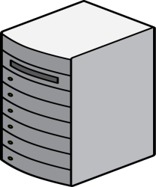
Oracle VM Template for MySQL
Pre-Installed & Pre-Configured
Full Integration & QA Testing
Single Point of Support
Oracle VM
Oracle VM
Automatic Fault Detection & Recovery
Secure Live Migration (SSL)
Oracle VM Manager
Oracle VM Server Pool
Oracle VM Servers
ocfs2
iSCSI / FC-AL
Notes:
Number of solns in this area – starting with Oracle VM Template
Virtual appliance - Intergrated stack of OS, VM and database available packaged
Includes all elements, so can rapidly provision a completely virtualised database stack onto a VM server pool on premise or in cloud
Pre-Installed & Pre-Configured
Full Integration & QA Testing
Single Point of Support
Whiteaper, can learn more

Slide 28
Windows Server Failover Clustering
Native Windows HA clustering with MySQL
Quorum (3rd vote), data (InnoDB + schema) & binaries (optional) stored in shared storage (iSCSI & FCAL)
Loss of service = couple of seconds + InnoDB recovery time
Cluster managed through MS Failover Cluster Management snap-in GUI
Notes:
Moving on from Linux to Windows environment, this is our top download platform
Had repl + MySQL cluster, but many Windows users wanted to use Windows native clustering services – so we’ve recently completed certification
Sees MySQL as a service running under M$ Cluster Mgmt GUI, no new s/w scripts are needed
Provides auto failover as well as planned migrations
Again, shared storage solution** Technical support for Windows Server Failover Clustering must be sourced from Microsoft.

Slide 29
Oracle Solaris Clustering
Kernel based heartbeating and monitoring
SPARC and x86. Solaris Virtualization-aware
MySQL agent included with Oracle Solaris Cluster
Learn more: http://www.oracle.com/technetwork/server-storage/solaris-cluster/overview/index.html
Notes:
Moving onto the Solaris environment – full single stack support for MySQL with Solaris Clustering on x86 or SPARC
Monitor MySQL status via a MySQL agent and can failover master or slave. Also be integrated with Solaris containers for virtulization
The MySQL agent is included with Oracle Solaris Cluster, learn more
http://www.oracle.com/technetwork/server-storage/solaris-cluster/overview/index.html

Slide 30
Oracle Linux and DRBD Stack
Application
Based on distributed storage
NOT physical shared storage
Synchronous replication at block device level eliminates risk of data loss
Open source, mature & proven
Certified and supported by Oracle
VIP
Services
MySQL
MySQL
DRBD
sync
DRBD
Cluster s/w
Pacemaker
Corosync
Oracle Linux
Oracle Linux
Hosts
Active
Standby
Notes:
Another solution – again Linux specific – but rather than use shared storage to ensure never lose data in event of node failure, uses sync repl over local, distributed storage
Use Corosync to provide clustering and membership services, Pacemaker is a resource manager, so manages failover and recovery of MySQL
Popular solution in open source community

Slide 31
MySQL Cluster Overview
HIGH SCALE, READS + WRITES
Auto-Sharding, Multi-Master
99.999% AVAILABILITY
Shared nothing, no Single Point of Failure
SQL + NoSQL
LOW TCO
ACID Compliant, OLTP + Real-Time Analytics
Self Healing + On-Line Operations
Key/Value + Complex, Relational Queries
SQL + Memcached + JavaScript + Java + HTTP/REST & C++
Open Source + Commercial Editions
Commodity hardware + Management, Monitoring Tools
REAL-TIME
Memory optimized tables with durability
Predictable Low-Latency, Bounded Access Time

Slide 32














































Who’s Using MySQL Cluster?
Notes:
Growing roster of users running Cluster – lots of telcos, fastest growth web and enterprise, see social gaming, online ecomm properties, content delivery
PayPal spoke earlier in the month at MySQL Connect conf how they built new payment fraud detection system out of MySQL, deployed globally across AWS, enabling them to read any write from anywhere in the world in under 1 sec, so grown from a specialisation in telco to serve a broad selection of use cases – now gojng into detail on next major step forward – Cluster 7.3
Pass to Andrew

Slide 33

PayPal
Company Overview
PayPal allows any business or individual with an email address to securely, conveniently and cost-effectively send and receive payments online.
Application
PayPal built a cloud-based globally-distributed database with 100 TB of user-related data based on MySQL Cluster. “Must NOT lose data” system, delivering 99,999% availability, transactional, with data available WW anywhere in < 1 Sec.
Why MySQL Cluster?
“You can achieve high performance and availability without giving up relational models and read consistency.” Daniel Austin, Chief Architect, PayPal

Slide 34

Alcatel-Lucent
Company Overview
Global telecommunications equipment company, focuses on fixed, mobile, and converged networking hardware, IP technologies, software, and services.
Application
MySQL Cluster CGE is at the heart of Alcatel-Lucent’s Subscriber Data Manager to deliver converged IMS services to mobile and fixed line users.
Why MySQL Cluster CGE?
Delivers the performance, scalability and availability required by this mission critical real-time application
Real-time read & write access for tens of millions of subscribers in a single system
Always-on service: no offline maintenance window for services users depend on (voice, SMS, email, Web, social media…)
Rapid delivery & low TCO

Slide 35








MySQL Cluster Architecture
Clients
Application Layer
Data Layer
MySQL Cluster Data Nodes
Notes:
Arch behind cluster. Apears as 1 logical database to app and developers, connect to any node, query is routed
Under covers, 3 types of nodes – intelligence in data nodes. Tables auto-sharded across commodity h/w. Each data node manages a shard or fragment of the db. Creates a replica – all updates sync replicated between replicas. If failure, failover less than 1 sec. Data nodes handle all cluster membership, failover and recovery
Connect to data nodes via Application layer, via MySQL Server, Could use one of NoSQL APIs, so these are cluster libraries embedded into your app
All multi master, so update from any node in app layer instantly available to any other node

Slide 36
MySQL Cluster Scaling
Clients
Application Layer
Data Layer
MySQL Cluster Data Nodes
Notes:
Arch behind cluster. Apears as 1 logical database to app and developers, connect to any node, query is routed
Under covers, 3 types of nodes – intelligence in data nodes. Tables auto-sharded across commodity h/w. Each data node manages a shard or fragment of the db. Creates a replica – all updates sync replicated between replicas. If failure, failover less than 1 sec. Data nodes handle all cluster membership, failover and recovery
Connect to data nodes via Application layer, via MySQL Server, Could use one of NoSQL APIs, so these are cluster libraries embedded into your app
All multi master, so update from any node in app layer instantly available to any other node

Slide 38
MySQL Cluster HA
Clients
Application Layer
Data Layer
MySQL Cluster Data Nodes
Notes:
Arch behind cluster. Apears as 1 logical database to app and developers, connect to any node, query is routed
Under covers, 3 types of nodes – intelligence in data nodes. Tables auto-sharded across commodity h/w. Each data node manages a shard or fragment of the db. Creates a replica – all updates sync replicated between replicas. If failure, failover less than 1 sec. Data nodes handle all cluster membership, failover and recovery
Connect to data nodes via Application layer, via MySQL Server, Could use one of NoSQL APIs, so these are cluster libraries embedded into your app
All multi master, so update from any node in app layer instantly available to any other node

Slide 39

MySQL Cluster Auto-Installer
Fast configuration
Auto-discovery
Workload optimized
Repeatable best practices
Auto-Discover
Specify Workload
Define Topology
Deploy

Slide 40

Active-Active Geo-Replication
Asynchronous replication between MySQL Clusters
Active-Active
Update anywhere
Conflict detection
Application notified through exception tables
Can opt to have conflicts resolved automatically
Auto-conflict-resolution
Conflicting transaction and dependent ones are rolled-back (MySQL Cluster 7.4 – pre GA)
No changes to application schema

Slide 41


When to Consider MySQL Cluster
Scalability demands
Sharding for write performance?
Latency demands
Cost of each millisecond?
Uptime requirements
Cost per minute of downtime?
Failure versus maintenance?
Application agility
Developer languages and frameworks?
SQL or NoSQL?
Notes:
Where would you use Cluster – impt to consider requirements of your app – and these are good questions to ask yourself as developers or architects
Concerns in any of these areas, ie high cost of downtime, app complexity in sharding or building in HA – then look at Cluster

Slide 42




MySQL Enterprise Edition
Advanced Features
Management Tools
Support
Scalability
High Availability
Security
Audit
Monitoring
Backup
Development
Administration
Migration
Technical Support
Consultative Support
Oracle Certifications
42

Slide 43


Slide 44


MySQL Enterprise Monitor
Application
Big Fish Games is a global leader in the online games industry and distributes more games worldwide than any other online site.
Key Business Benefit
MySQL Query Analyzer provides a consolidated view of query activities and execution details, and has enabled Big Fish Games to quickly identify poorly running queries and tackle the root causes directly in the SQL code.
Why MySQL?
“With the MySQL Query Analyzer, we were able to identify and analyze problematic SQL code, and triple our database performance. More importantly, we were able to accomplish this in three days, rather than taking weeks.”
Keith Souhrada, Software Development Engineer, Big Fish Games

Slide 45
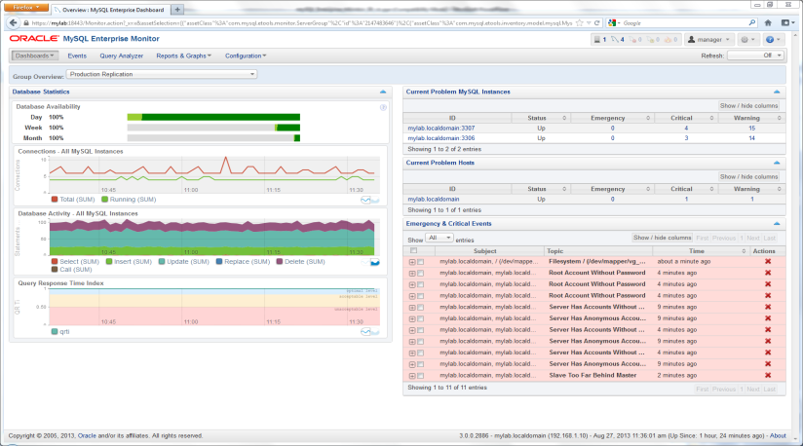
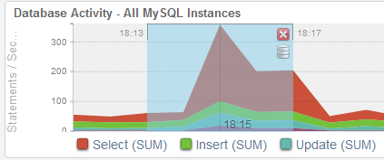
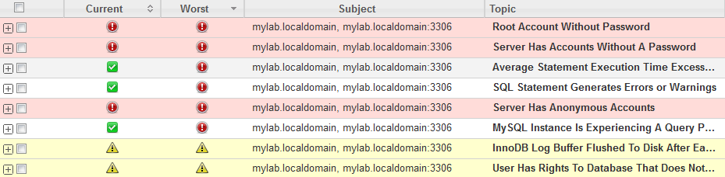
MySQL Enterprise Monitor
Start monitoring MySQL in 10 minutes
Real-time MySQL performance and availability monitoring
Visually find & fix problem queries
Disk monitoring for capacity planning
Cloud friendly architecture
No agents required
Optional agent option provides advanced Host/OS monitoring

Slide 46

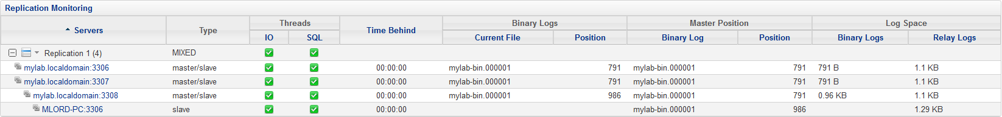
Enterprise Replication Monitor
Auto-discovers replication topology
Master/Slave performance monitoring
Replication advisor
Best practice replication advice
"I use the MySQL Enterprise Monitor every day to monitor and keep tabs on our MySQL databases. Quick one stop shopping for keeping tabs on them.”
Wes Homer,
Sr System and Network Administrator

Slide 47
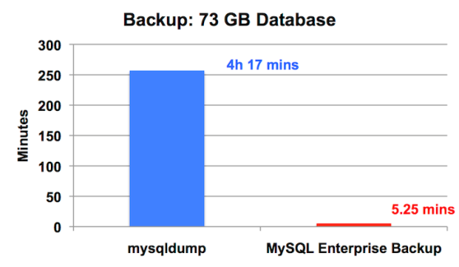
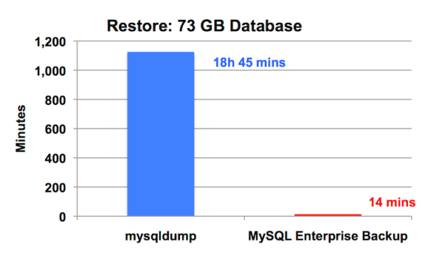
MySQL Enterprise Backup
Online, non-locking backup and recovery
Complete MySQL instance backup (data and config)
Partial backup and restore
Direct Cloud storage backups (S3, etc.)
Incremental backups
Point-in-time recovery
Advanced compressed and encryption
Backup to tape (SBT)
Backup validation
Optimistic backups
Cross-Platform (Windows, Linux, Unix)
47

Slide 48
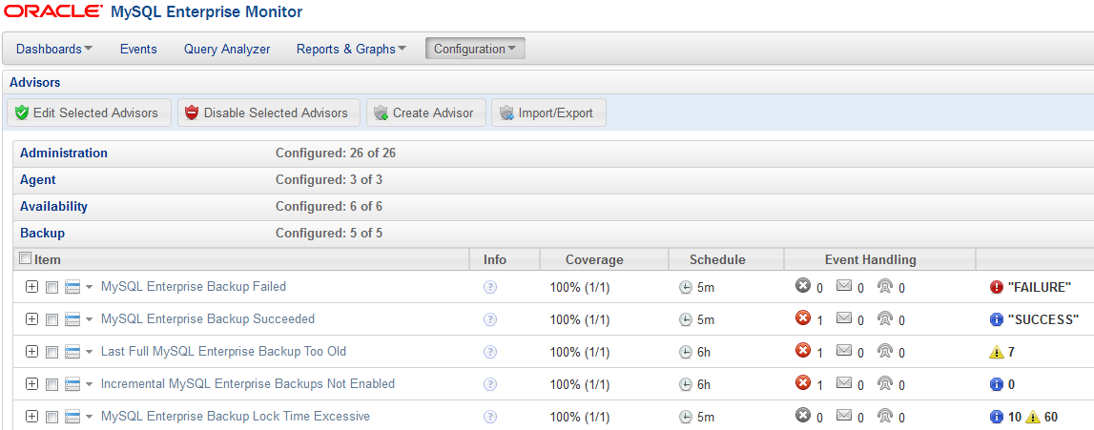
MySQL Enterprise Monitor + Backup
Monitor backup results
Monitor backup performance
Ensure backups are up to date

Slide 49
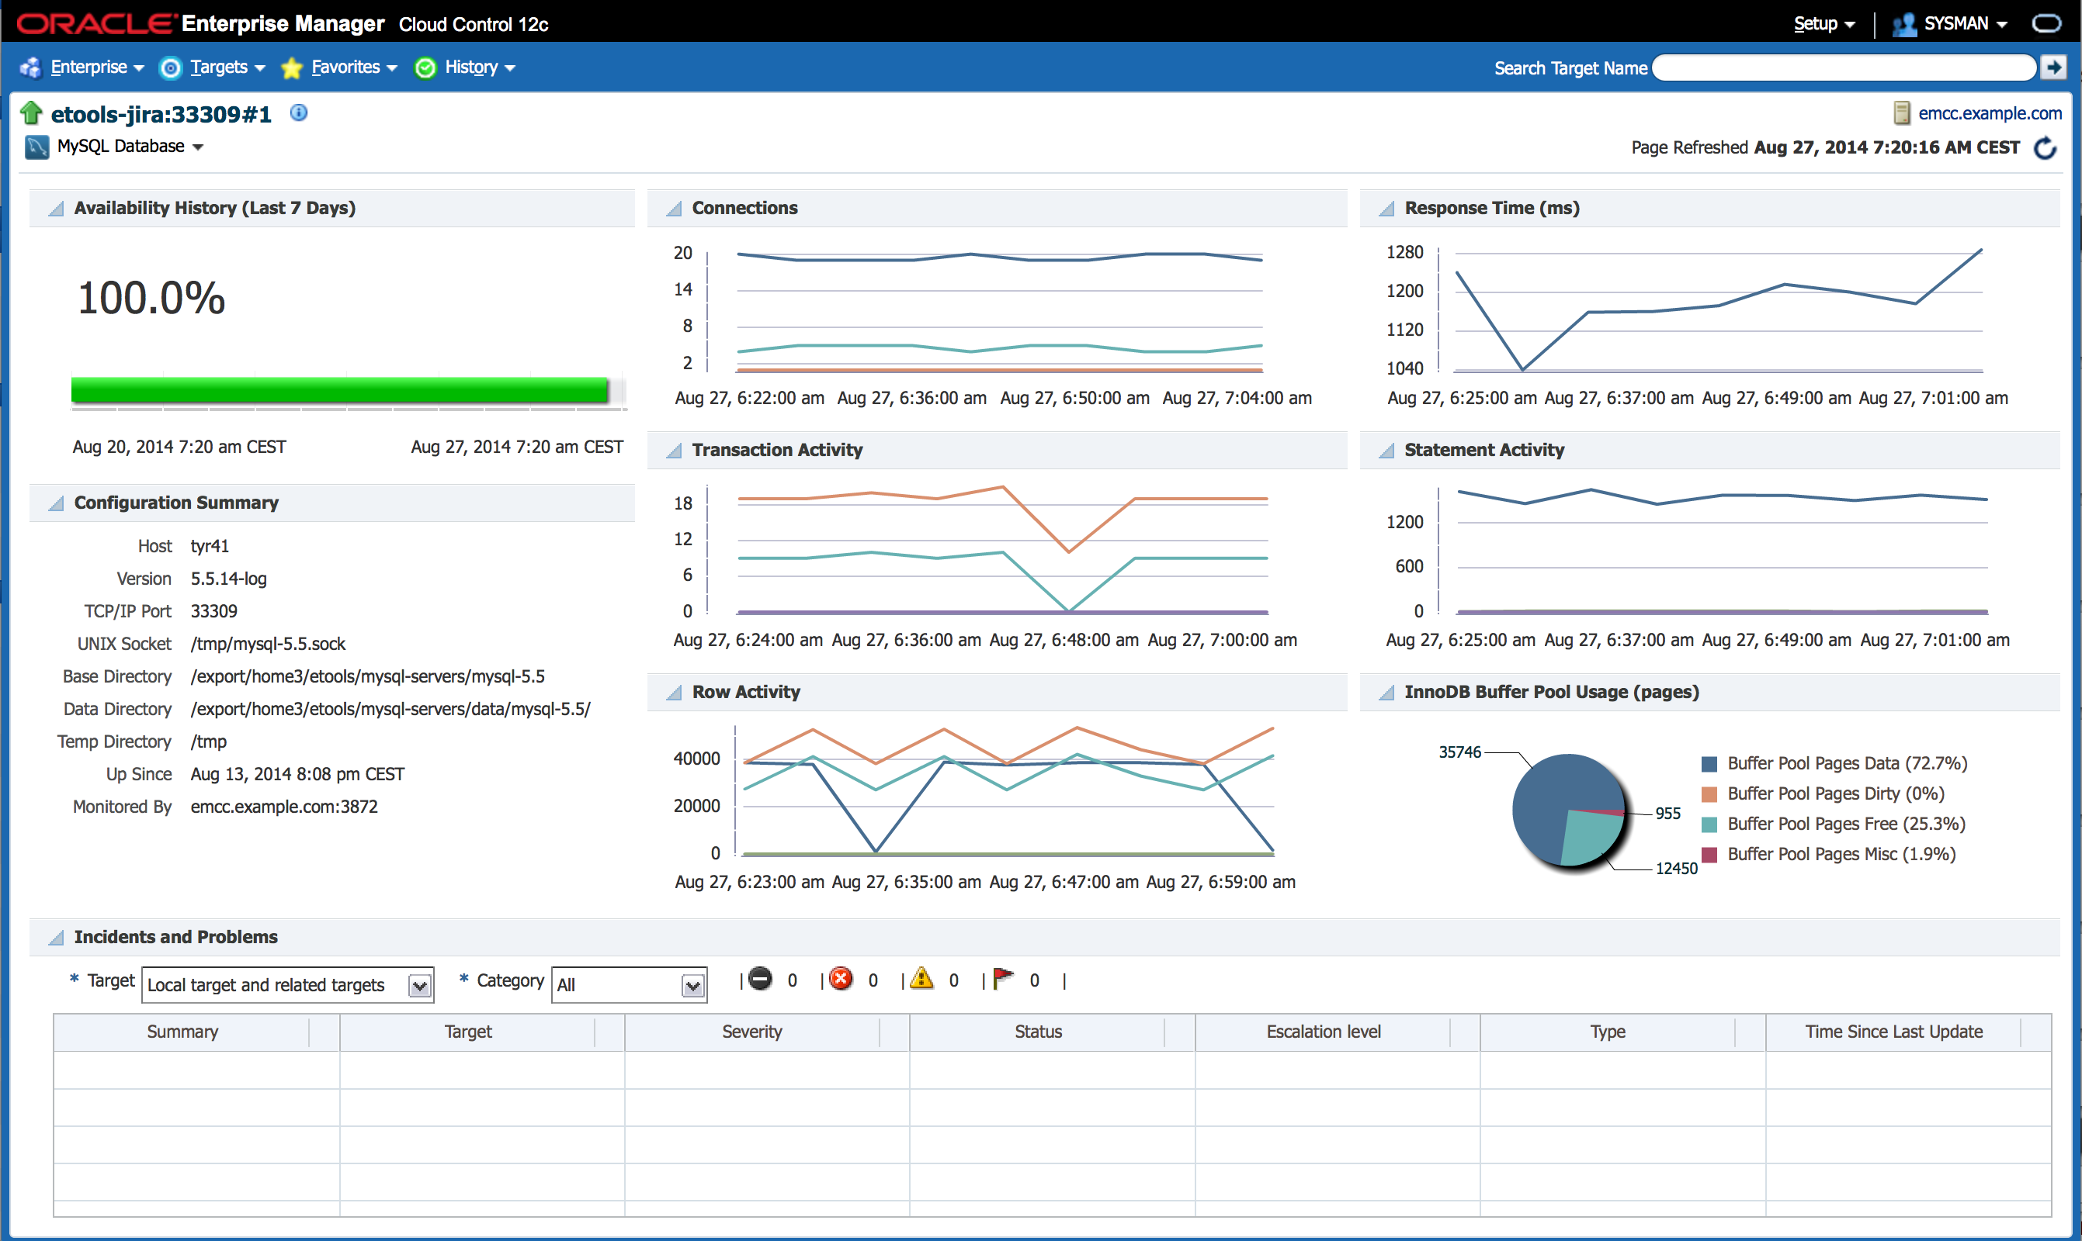

Oracle Enterprise Manager for MySQL
Availability monitoring
Performance monitoring
Configuration monitoring
All available metrics collected
Allowing for custom threshold based incident reports
MySQL auto-detection
Performance
Security
Availability

Slide 50
Oracle Premier Support for MySQL
Rely on The Experts - Get Unique Benefits
Only From Oracle
Straight from the Source
Largest Team of MySQL Experts
Backed by MySQL Developers
Forward Compatible Hot Fixes
MySQL Maintenance Releases
MySQL Support in 29 Languages
24/7/365
Unlimited Incidents
Knowledge Base
MySQL Consultative Support
"The MySQL support service has been essential in helping us with troubleshooting and providing recommendations for the production cluster, Thanks."
-- Carlos Morales – Playfulplay.com
Notes:
Within our commercial editions, the database and tools are all backed by Oracle 24x7, global support for MySQL, staffed by the largest team of MySQL experts and backed directly by the engineers that develop MySQL
Access to best practices Knowledge Base which offers great insight into how to configure, provision and manage highly available MySQL environments.
Unlimited support incidents
Hot fixes, Maintenance releases, bug fixes, patches and updates
MySQL consultative support

Slide 51
MySQL Cluster CGE
MySQL Cluster Manager
MySQL Enterprise Scalability
MySQL Enterprise Audit
MySQL Enterprise Security
Oracle Premier Lifetime Support
Oracle Product Certifications
MySQL Enterprise Mornitor
MySQL Workbench

Slide 52

Enhancing DevOps Agility, Reducing Downtime
Automated Management
Start / Stop node or whole cluster
Self-Healing
Node monitoring
HA Operations
Cluster-wide configuration consistency
On-Line Scaling
On-Line Reconfiguration
On-Line Upgrades
On-Line Backup & Restore
Import Running Cluster
Auto-recovery extended to SQL + mgmt nodes
Persistent configurations
HA Agents
Notes:
To further simplify administration, MySQL Cluster Manager 1.2 automates the integrated on-line back-up and restore functionality of MySQL Cluster. DBAs no longer need to log-in to each individual data node to view and / or restore a backup. Using MySQL Cluster Manager 1.2, restore operations are reduced to a single, simple command.

Slide 53
Software Upgrade – example of benefits of MCM?
Without MySQL Cluster Manager
With MySQL Cluster Manager
1 x preliminary check of cluster state
8 x ssh commands per server
8 x per-process stop commands
4 x scp of config files (2 x mgmd & 2 x mysqld)
8 x per-process start commands
8 x checks for started and re-joined processes
8 x process completion verifications
1 x verify completion of the whole cluster.
Excludes manual editing of each configuration file.
Total: 46 commands
2.5 hours of attended operation
mcm> upgrade cluster --package=7.4 mycluster;
Total: 1 Command -
Unattended Operation
Notes:
Lets look at a real world example to demonstrate the capabilities of MCM
In this example, we want to upgrade Cluster from release 7.0 to the latest 7.2. This operation can be performed on-line without downtime to applications or clients accessing the cluster
It can be done manually today – however, this config of 8 servers would require total of 46 commands, and would require 2.5 hours of handholding the process for the duration, by following the steps shown on the slide. Very important they perform each step in turn, follow correct procedures, restart data nodes in correct sequence – otherwise downtime can result
With MCM, this can be accomplished with 1 command, once issued, admin can walk away and get on with other stuff
Results
Reduces the overhead and complexity of managing database clusters
Reduces the risk of downtime resulting from administrator error
Automates best practices in database cluster management
Operation could be scripted, but then it takes time to develop and test the scripts, then maintain them going forward – all of which adds cost, risk and complexity
Example based on a MySQL Cluster configuration comprised of 4 x MySQL Cluster Data Nodes, 2 x MySQL Server SQL Nodes and 2 x MySQL Cluster Management Nodes implemented across individual servers (8 x total).
Based on a DBA restarting 4 x MySQL Cluster Data Nodes, each with 6GB of data, and performing 10,000 operations per second http://www.clusterdb.com/mysql-cluster/mysql-cluster-data-node-restart-times/
Excludes the preparation steps of copying the new software package to each host and defining where it's located: Mysql> add package --basedir=/usr/local/mysql_7_0_7 7.0;

Slide 54
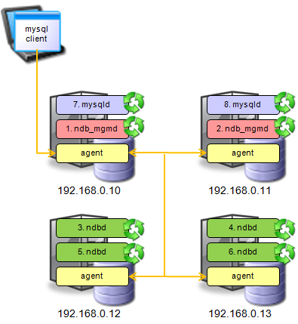
MCM: Upgrade Cluster
mcm> upgrade cluster --package=7.3 mycluster;

Slide 55
Oracle University MySQL Training Services Prepare Your Organization to Enable Reliable and High-Performance Web-Based Database Applications
Benefits
RECENTLY RELEASED
!!ALL NEW!! MySQL Cluster Training To Register your interest to influence the schedule on this newly released course – go to education.oracle.com/mysql and click on the MySQL Cluster Course
Expert-led training to support your MySQL learning needs
Flexibility to train in the classroom or online
Hands-on experience to gain real world experience
Key skills needed for database administrators and developers
MySQL for Beginners
MySQL for Database Administrators
MySQL Performance Tuning
MySQL Cluster – NEW - Register Your Interest!
MySQL and PHP - Developing Dynamic Web Applications
MySQL for Developers
MySQL Developer Techniques
MySQL 5.6 Database Administrator
MySQL 5.6 Developer
To find out more about available MySQL Training & Certification offerings, go to: education.oracle.com/mysql
Top Courses for Administrators and Developers
“Training and team skill have the most significant impact on overall performance of technology and success of technology projects.” - IDC, 2013
Top Certifications
Premier Support customers eligible to save 20% on learning credits.
Notes:
This is a sample Picture with Caption Layout slide ideal for including a picture with a brief descriptive statement.
To Replace the Picture on this Sample Slide (this applies to all slides in this template that contain replaceable pictures)
Select the sample picture and press Delete. Click the icon inside the shape to open the Insert Picture dialog box. Navigate to the location where the picture is stored, select desired picture and click on the Insert button to fit the image proportionally within the shape.
Note: Do not right-click the image to change the picture inside the picture placeholder. This will change the frame size of the picture placeholder. Instead, follow the steps outlined above.

Slide 56
White Papers & Webinar Replays
High Availability
http://www.mysql.com/why-mysql/white-papers/#en-22-16
http://www.mysql.com/news-and-events/on-demand-webinars/#en-20-16
MySQL Cluster
MySQL Replication
http://www.mysql.com/news-and-events/on-demand-webinars/#en-20-38
http://www.mysql.com/why-mysql/white-papers/#en-22-38
http://www.mysql.com/news-and-events/on-demand-webinars/#en-20-28
http://www.mysql.com/why-mysql/white-papers/#en-22-28

